Slide 1


Team 1 Aniket Patil Dipali Patil Mamta Jeswani Rutuja Deshmukh Shubham Nagpure
P166 – Apple Stock Price Forecast
Mentor – Neha Gupta
09/12/2022

Slide 2


Introduction
Stock market is an aggregation stockbrokers and traders who can buy and sell shares of stocks.
Stock data is non-stationary, chaotic, random and depends on several technical parameters.
Since statistical approaches are linear in nature, it hampers prediction performances in case of sudden rise or fall of prices of the stocks.
In modern days of artificial intelligence, machine learning plays an important role in time series predictions.
Apple Inc. is an American multinational technology company headquartered in Cupertino, California, United States.
Apple is the largest technology company by revenue (totaling US$365.8 billion in 2021).
As of June 2022, it’s the world's biggest company by market capitalization.
The fourth-largest personal computer vendor by unit sales and second-largest mobile phone manufacturer.
It is one of the Big Five American information technology companies, alongside Alphabet, Amazon, Meta, and Microsoft.

Slide 3
BUSINESS PROBLEM
To predict the price of Apple stock for next 30 days on the basis of given data.
BUSINESS OBJECTIVE
Predict the stock price of APPLE for next 30 days on the basis of given data.
Build a model to predict the price for the said period by splitting the data into train and test set.
Find trends in short term and long term.
Impact of external factors or any events.
Methodologies
ARIMA
SARIMA
HOLT – Winter Method

Slide 4
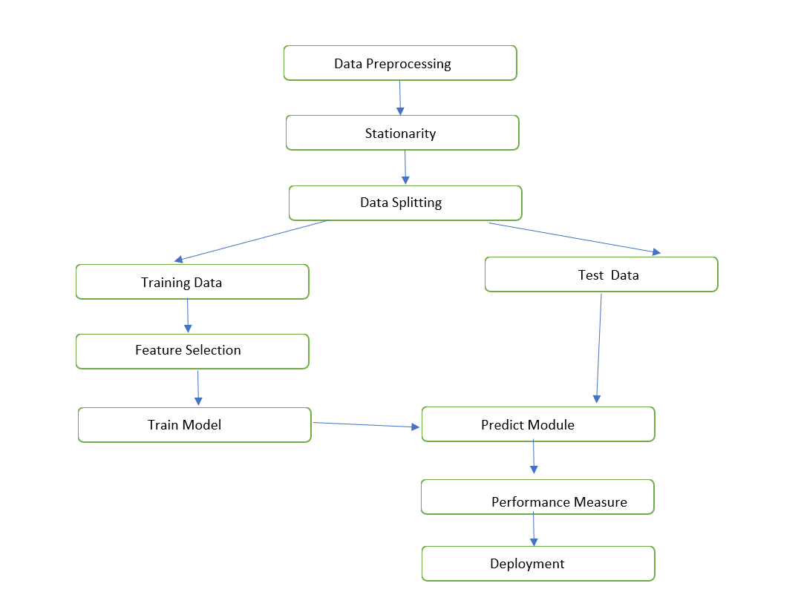
PROJECT WORK FLOW

Slide 5
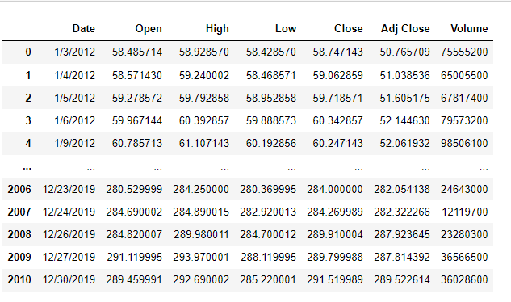
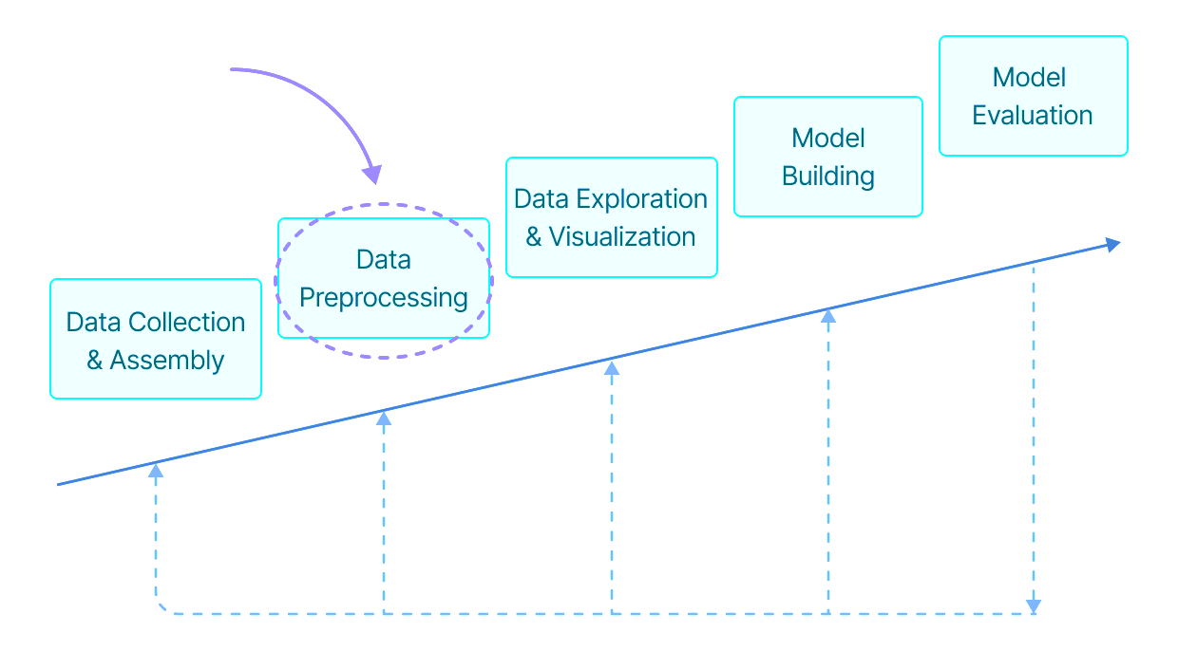
DATASET & Pre-Processing
The data used in this project consists of the historical stock prices of AAPL obtained via Yahoo Finance.
Dataset contains the following variables; Date (January 2012 - December 2019), Open, High, Low, Close, Adjusted Close and Volume.
Dataset contains 2011 rows and 7 columns.
It has float and integer values and is in Object type.
There are no null values in the data.
There are no duplicates in the data.
Data is highly correlated.

Slide 6
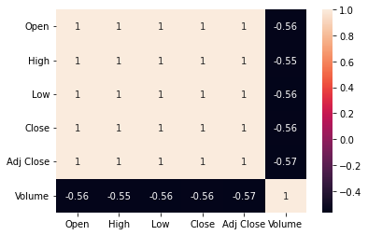
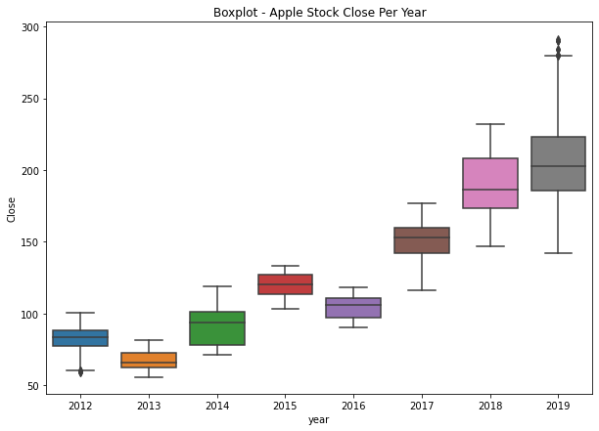
EDA Visualization
HEATMAP
BOXPLOT – CLOSE PRICE

Slide 7
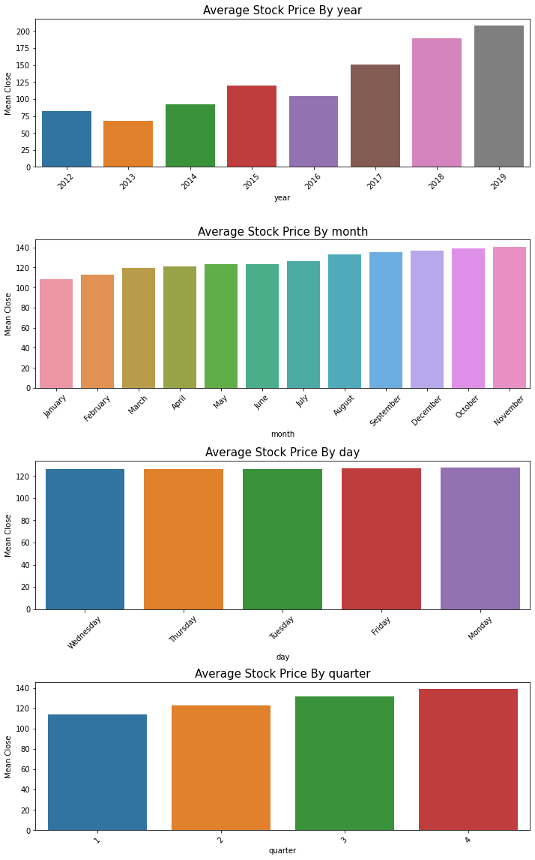
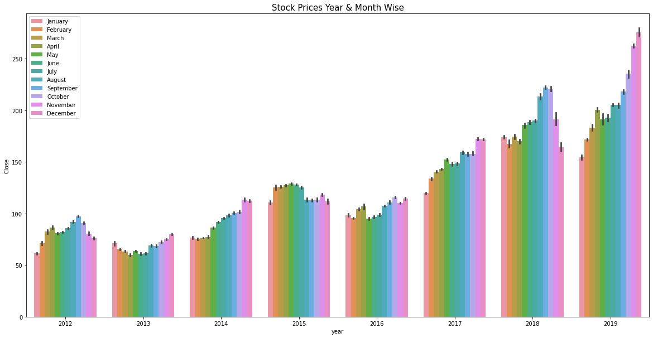
EDA Visualization (Continued)
AVERAGE STOCK PRICE BY
STOCK PRICES YEAR & MONTH WISE

Slide 8
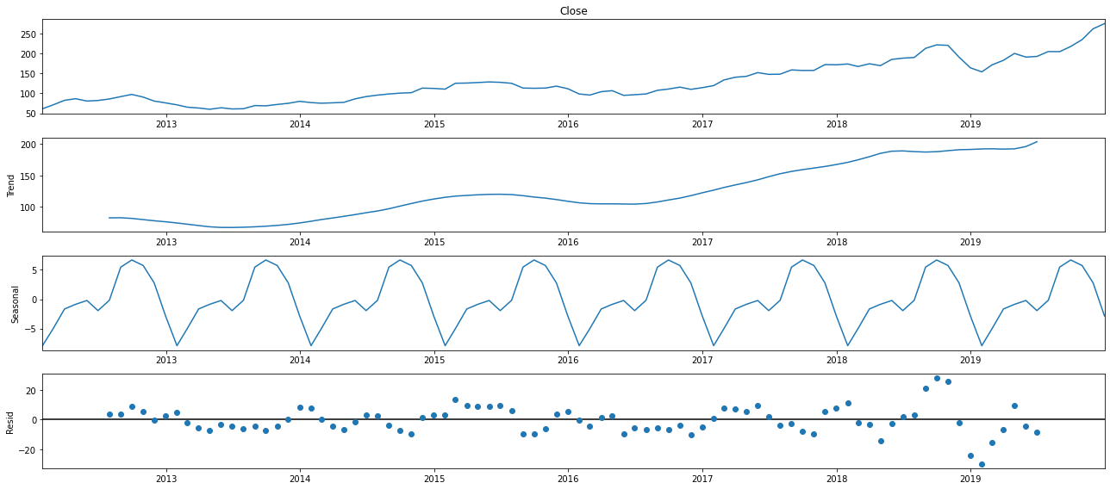
Decomposition of time series

Slide 9
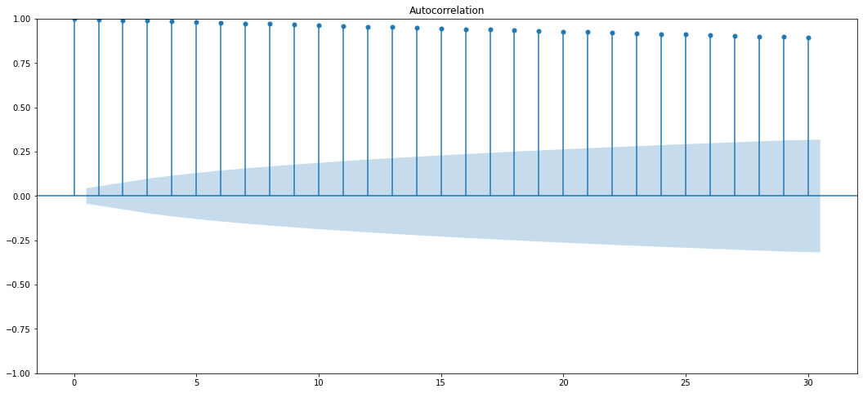
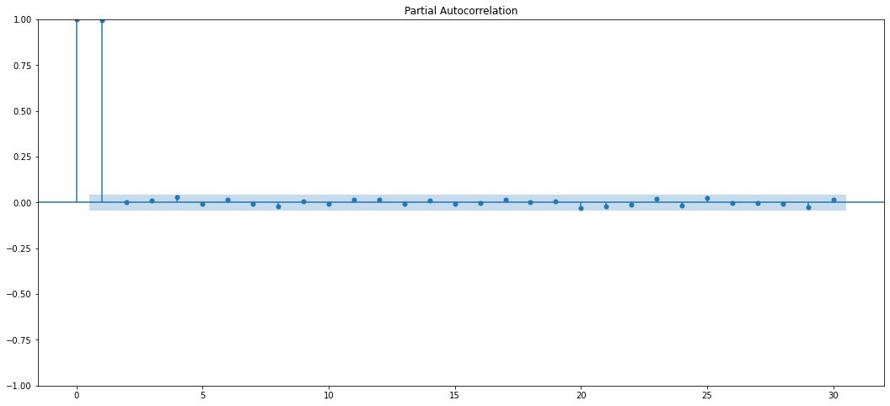
ACF plots and PACF plots (Before Differencing)
ACF PLOT
PACF PLOT
ADF TEST
ADF Test Statistic : 1.2193479467002406
p-value : 0.9961168706935021
#Lags Used : 9
Number of Observations used : 2001
Accept Null Hypothesis. Data is Non – Stationary

Slide 10
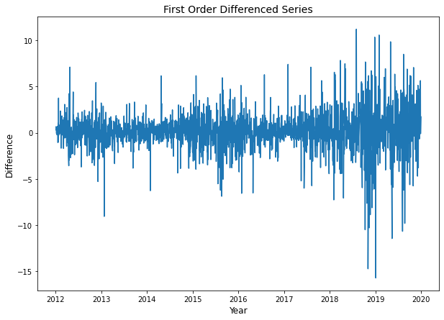
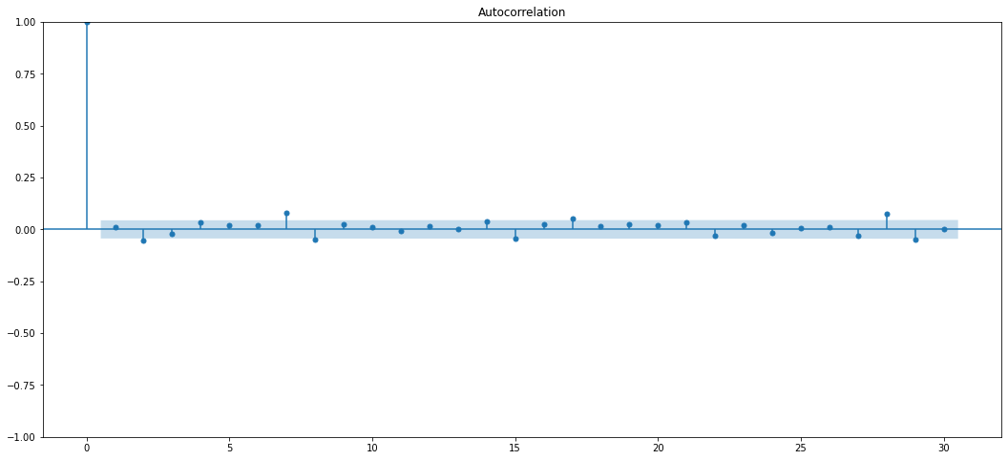
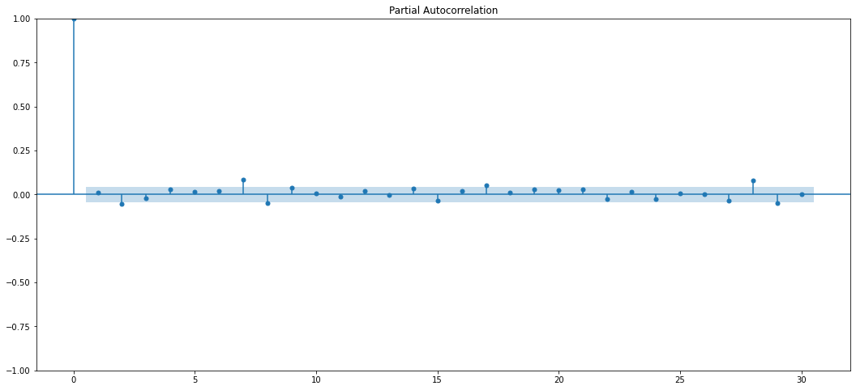
Differencing
ACF PLOT (AFTER DIFFERENCING)
PACF PLOT (AFTER DIFFERENCING)
ADF Test Statistic : -13.62553837607382
p-value : 1.7630934279439484e-25
#Lags Used : 8
Number of Observations used : 2001
Reject Null Hypothesis. Data is Stationary

Slide 11
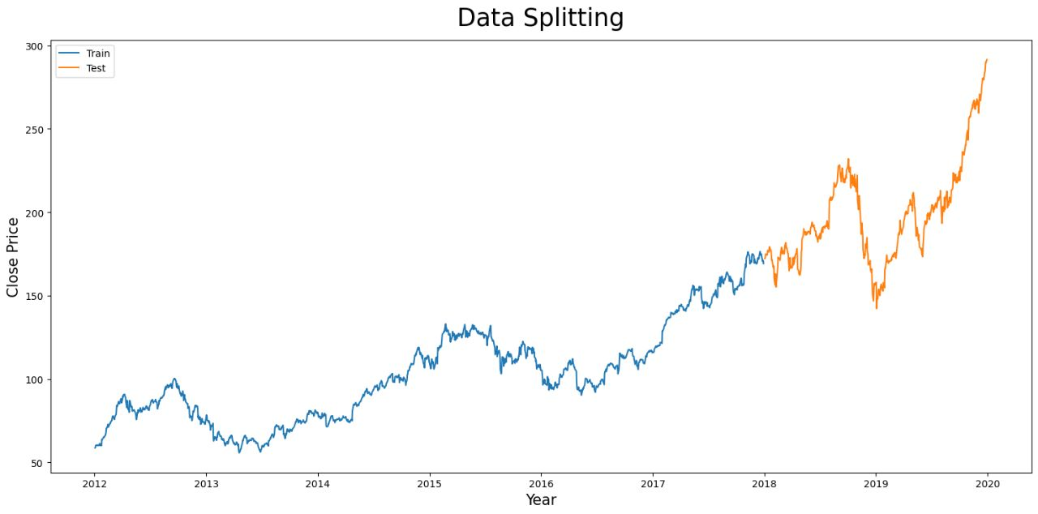
Data Splitting
Dataset has been divided into two parts –
Train Data – 2012-02-03 to 2017-12-29
Test Data – 2018-01-02 to 2019-12-30

Slide 12
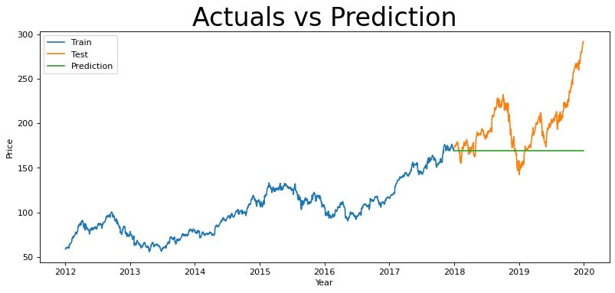

ARIMA
(1,1,1)
ARIMA – Auto Regression Integrated Moving Average Model.
It goes through differencing steps to eliminate the non-stationary part.
ARIMA Models are specified by three order parameters: (p, d, q),
where,
p is the order of the AR term
q is the order of the MA term
d is the number of differencing required to make the time series stationary
An ARIMA model is one where the time series was differenced at least once to make it stationary and we combine the AR and the MA terms. So the equation of an ARIMA model becomes :
MODEL PARAMETER SUMMARY
Order | RMSE | MAPE | AIC | BIC
(2,1,2) | 41.66 | 0.186209753 | 5590.958 | 5617.551
(0,1,0) | 41.69 | 0.186468921 | 5592.981 | 5598.3
(1,1,1) | 41.72 | 0.18670157 | 5595.408 | 5611.363
(0,1,1) | 41.72 | 0.18675199 | 5593.898 | 5604.535
(1,1,0) | 41.72 | 0.186738612 | 5593.97 | 5604.607
(3,1,2) | 41.72 | 0.186726995 | 5595.41 | 5627.322
(7,1,4) | 41.78 | 0.187168596 | 5604.782 | 5668.604
(5,1,1) | 41.78 | 0.187173087 | 5600.775 | 5638.005

Slide 13
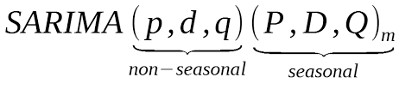
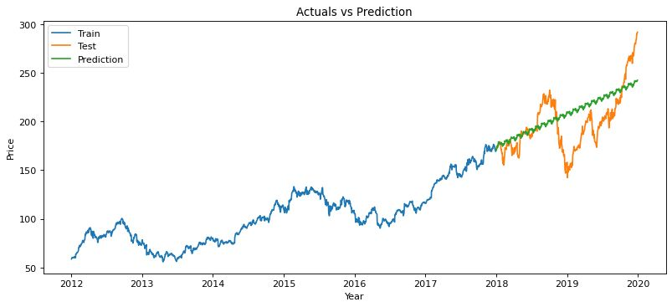
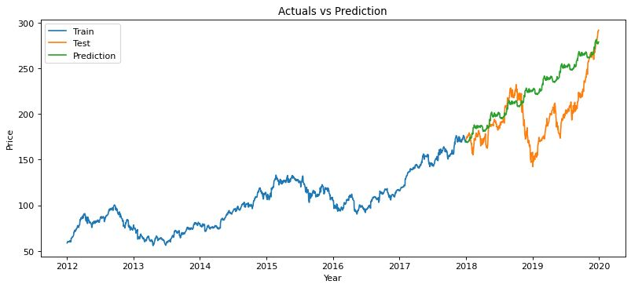
sARIMA
Order | RMSE | MAPE | AIC | BIC
(0, 1, 2) x (1, 1, 0, 22) | 24.86 | 0.094798073 | 6159.171 | 6180.387
(1, 1, 1) x (0, 1, 1,66 ) | 26.59 | 0.102348962 | 5581.35 | 5602.445
(0, 1, 1) x (0, 1, 1, 66) | 26.59 | 0.102366682 | 5579.685 | 5595.506
(0, 1, 2) x (1, 1, 1, 22) | 26.64 | 0.102443732 | 5615.706 | 5642.225
(0, 1, 1) x (0, 1, 2, 22) | 26.68 | 0.102669109 | 5614.862 | 5636.077
(1, 1, 1) x (0, 1, 1, 22) | 26.77 | 0.103236624 | 5618.986 | 5640.201
(0, 1, 1) x (0, 1, 1,22) | 26.78 | 0.103263857 | 5617.46 | 5633.372
(0, 1, 2) x (1, 1, 1, 5) | 26.84 | 0.103656467 | 5608.674 | 5635.25
(1, 1, 1) x (0, 1, 1, 5) | 26.85 | 0.103685433 | 5607.932 | 5629.193
(0, 1, 1) x (0, 1, 1, 5) | 26.85 | 0.103713639 | 5606.452 | 5622.397
(0, 1, 1) x (0, 1, 2, 5) | 26.87 | 0.10382165 | 5608.395 | 5629.655
(0, 1, 2) x (1, 1, 1, 66) | 26.87 | 0.103913146 | 5580.69 | 5607.059
(0, 1, 1) x (0, 1, 2, 66) | 26.94 | 0.104281653 | 5579.666 | 5600.761
(0, 1, 2) x (1, 1, 0, 66) | 36.42 | 0.122709843 | 6040.232 | 6061.327
(0, 1, 2) x (1, 1, 0, 5) | 203.74 | 19.95183142 | 6167.292 | 6188.553
(1,1,1) x (1, 1, 1, 5) | 26.83 | 0.103574486 | 5610.108 | 5636.684
(1,1,1) x (1, 1, 1, 22) | 26.66 | 0.102549963 | 5616.532 | 5643.051
(1,1,1) x (1, 1, 1, 66) | 26.88 | 0.103967534 | 5581.519 | 5607.888
An extension to ARIMA that supports the direct modeling of the seasonal component of the series is called SARIMA - Seasonal Autoregressive Integrated Moving Average.
There are four seasonal elements that are not part of ARIMA that must be configured; they are:
P: Seasonal autoregressive order.
D: Seasonal difference order.
Q: Seasonal moving average order.
m: The number of time steps for a single seasonal period.
(0, 1, 2) x (1, 1, 0, 22)
(0, 1, 2) x (1, 1, 0, 66)

Slide 14
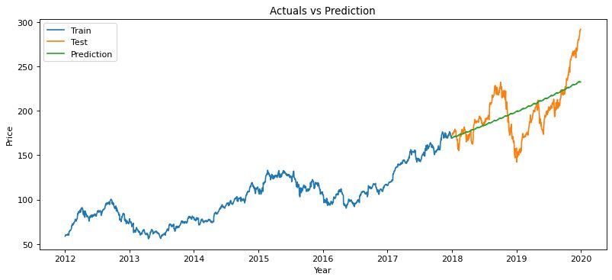
Holt-wINTER’S Method
Holt-Winters is a model of time series behavior. Forecasting always requires a model, and Holt-Winters is a way to model three aspects of the time series: a typical value (average), a slope (trend) over time, and a cyclical repeating pattern (seasonality).
HOLT-WINTERS EXPONENTIAL SMOOTHING (TRIPLE ES)

Slide 15
Conclusion
1)We have selected the SARIMA model because our data is Seasonal.
2) SARIMA has more input parameters than Holt-Winters Method and has a better prediction.
3) SARIMA model is accurate on short-period forecasting but less accurate on long-period forecasting.
Thank you!

